Slide 1
Build your own copilot with Teams AI Library and .NET
Ayça Baş
John Miller

Slide 2
Agenda
01
02
03
Copilot stack
Teams AI Library
Teams Toolkit

Slide 3



Copilot extensions
Extend Microsoft Copilot
Build your own copilot
Copilot
Your copilot
Low & pro-code
Copilot
Studio
Visual Studio
Code

Slide 4
Copilot extensions
Ground responses
Bring actions
Focus user experiences
Connectors
Plugins
Your copilots
Your business knowledge
Your apps
Your business knowledge
Your workflows
Your apps
Your automation
Your workflows
Your automation

Slide 5
Copilot extensions
Ground responses
Bring actions
Focus user experiences
Connectors
Plugins
Your copilots
Your business knowledge
Your apps
Your business knowledge
Your workflows
Your apps
Your automation
Your workflows
Your automation

Slide 6

Building your copilot
Teams
Teams AI Library
+
Bot Framework
LLM

Slide 7
Building your copilot
Teams
Teams AI Library
+
Bot Framework
LLM
Model:
Orchestrators, foundational models, and data

Slide 8
Building your copilot
Teams
Conversational Interface:
Instructions, Actions, Handlers, Triggers, and Intent Detection
Teams AI Library
+
Bot Framework
LLM
Model:
Orchestrators, foundational models, and data

Slide 9
Building your copilot
Teams
Conversational Interface:
Instructions, Actions, Handlers, Triggers, and Intent Detection
Teams AI Library
+
Bot Framework
LLM
Model:
Orchestrators, foundational models, and data
.NET, JS, Python

Slide 10
Building your copilot
UX:
Streaming, Citations, Feedback Looping, and more
Teams
Conversational Interface:
Instructions, Actions, Handlers, Triggers, and Intent Detection
Teams AI Library
+
Bot Framework
LLM
Model:
Orchestrators, foundational models, and data
.NET, JS, Python

Slide 11

Before
Bots use a primitive list of declared commands
No understanding of app skills
Hard to utilize user intention

Slide 12
With the Teams AI Library
Bots are evolving to be conversational copilots
Apps can register skills
Extract user intent from natural language

Slide 13

Conversational and contextual
Truly conversational Teams apps built with purpose to leverage app skills
@bot make a task for Babak from this
M365 interface to LLMs
Built-in natural language processing, akin to ChatCopilot Extension, with prompt engineering and moderation
Copilot built with the Teams AI Library
LLM
Microsoft 365
Planning engine that guides conversation to extract intents and map to app actions
Here’s the new task for Babak, everything look good
LLM modularity – developers can use any LLM they choose

Slide 14
Get started in 4 simple steps
Create AI components
1
Create application object
2
Add prompts
3
Add actions
4

Slide 15
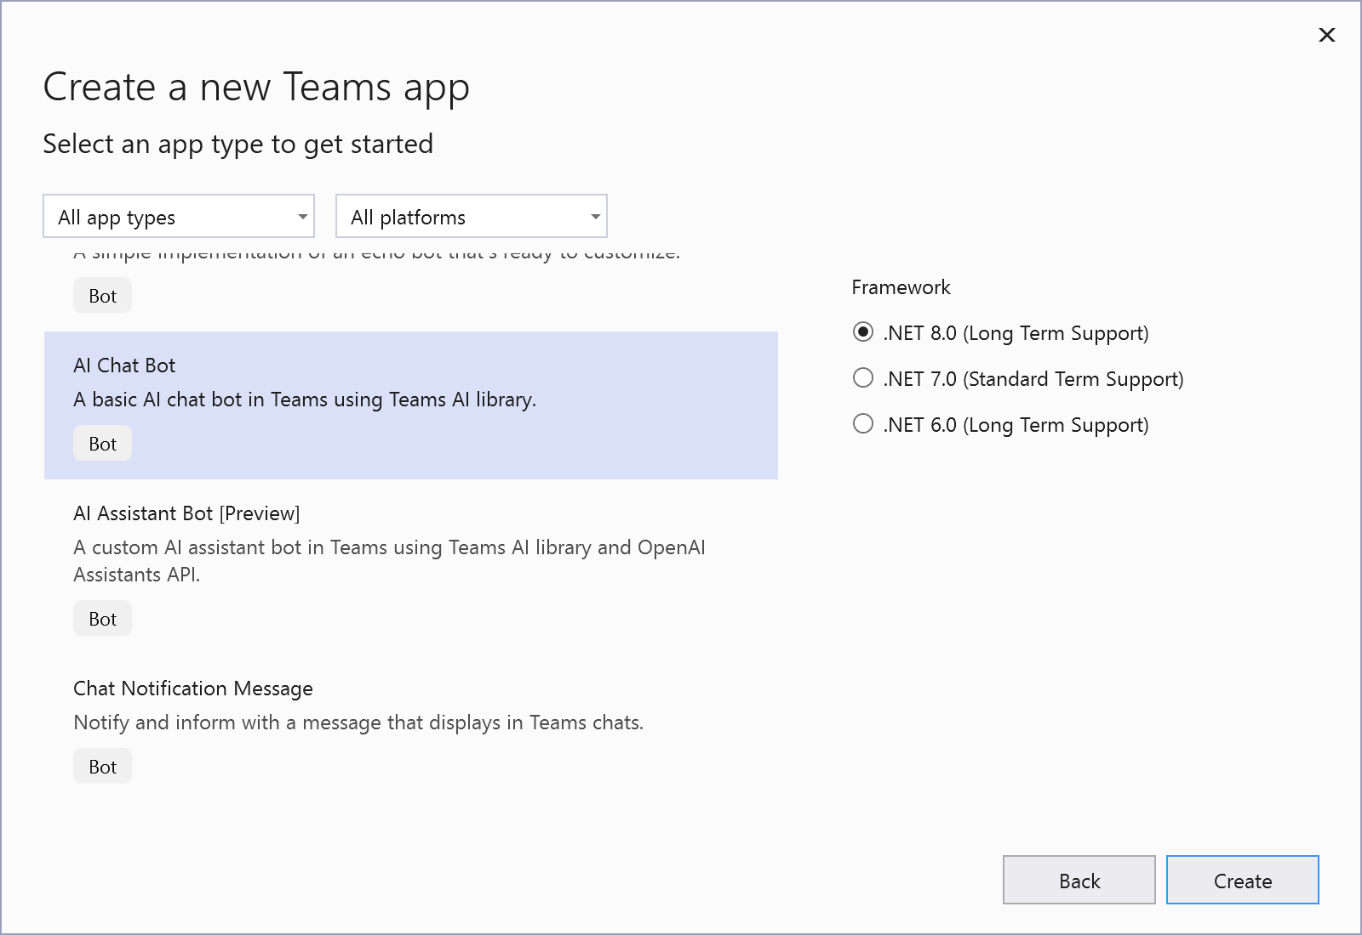
Teams Toolkit for Visual Studio
Developer tools for building custom copilots and apps for Teams, Outlook, and the M365 app.

Slide 16
DEMO

Slide 17
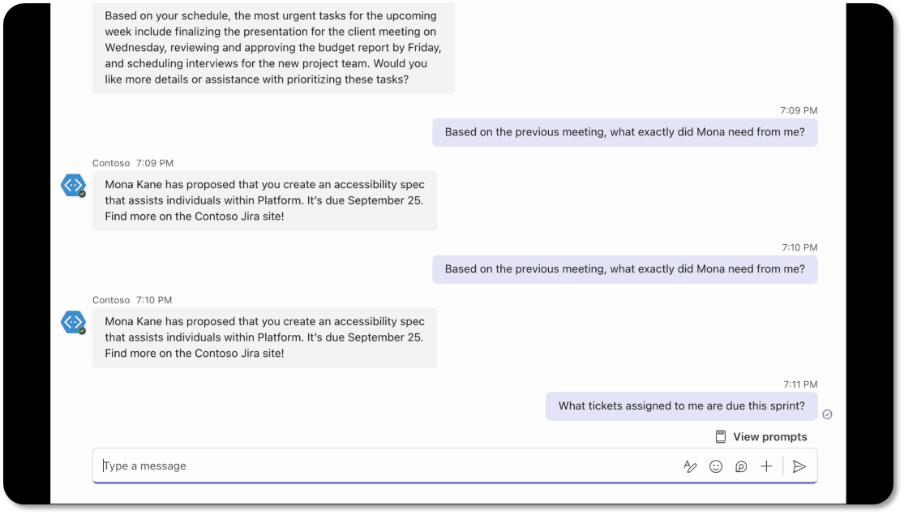
Powered by AI Kit
Streaming UX
AI labels
Citations
Feedback loop
Copilot handoffs
Bot and Stage 🤝

Slide 18
Building your copilot
UX:
Streaming, Citations, Feedback Looping, and more
M365
Conversational Interface:
Instructions, Actions, Handlers, Triggers, and Intent Detection
Teams AI Library
Bot Framework
LLM
Model:
Orchestrators, foundational models, and data
.NET, JS, Python

Slide 19
aka.ms/TryTeamsToolkit
Try it today!
With Teams AI Library
Notes:
If you want to get started, Try Teams Toolkit and the AI Library today.

Slide 20
Teams Toolkit repo: aka.ms/ttk
AI Library GitHub repo: aka.ms/teams-ai-repo
Powered by AI UX: aka.ms/powered-by-ai
Adaptive Card starter pack: aka.ms/teams-card-starters
References

Slide 21

.NET Conf: Focus on AI
Learn more
aka.ms/dotnetFocusAI/Collection

